Slide 1
HOST-SYMBIONT
POPULATION GENOMICS
Intraspecific variability
in methanogenic symbionts
of marine anaerobic ciliates
Facilitator: JOHANA ROTTEROVA, University of Rhode Island
jrotterova@uri.edu
Mentor: CORINNA BREUSING, University of Rhode Island
Researcher: ROXANNE BEINART, University of Rhode Island
02/09/2022

Slide 2
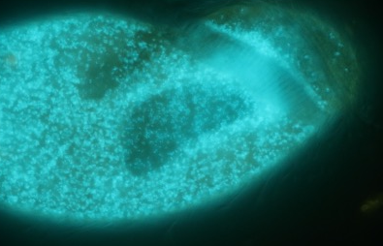
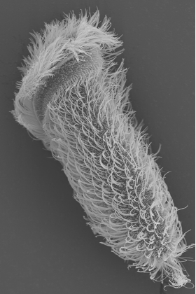
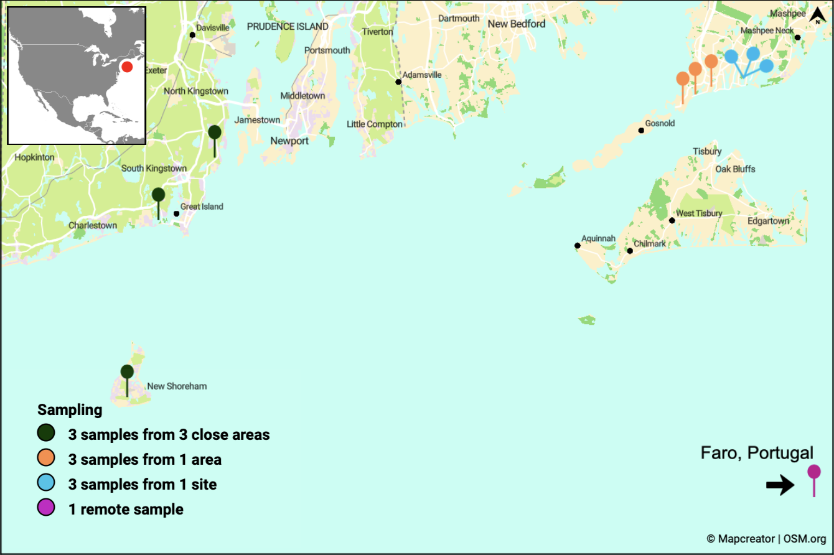
HOST-SYMBIONT
POPULATION GENOMICS
archaea-eukaryotes symbioses in anoxic coastal sediments of New England
populations of single host species isolated from various locations
analyzing the intraspecific genetic variability of methanogenic archaeal endosymbionts of genus Methanocorpusculum hosted by a marine anaerobic ciliate Metopus sp. F25B

Slide 3
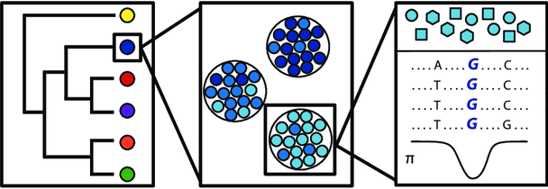
HOST-SYMBIONT
POPULATION GENOMICS
Goals
Phylogenetic analysis of 18S/ITS/16S strain specific diversity of host and symbionts including publicly available environmental sequences
Transcriptomics of host to create a reference for the genome
Population genomics - genetic variability of symbionts within 1 host
- 7 single cells/pop.
- 15 pop./species
- 1 species
Napflin et al. 2019 DOI: 10.7717/peerj.8013

Slide 4
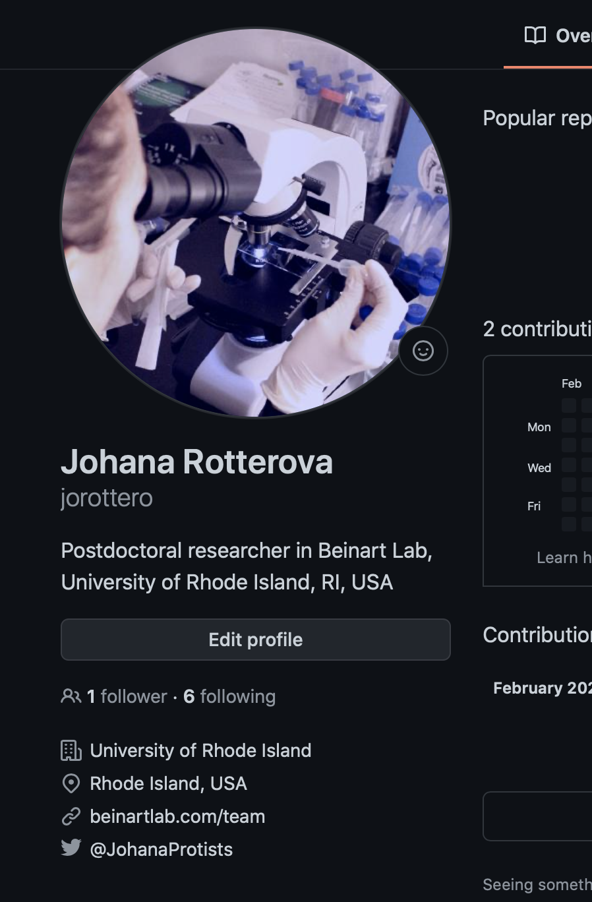
HOST-SYMBIONT
POPULATION GENOMICS
Timeframe
from January 2022 to June 2022
What I hope to learn
using HPC Andromeda vs Brown’s HPC Oscar
adapting scripts for new HPC and data type
creating pipelines
(using RCORRECTOR, TRINITY, TRIMMOMATIC, Spades, WINSTONCLEANER, GB Tools, RAST-TK, CHECKM, ..)
developing github repository
for the project
(https://github.com/jorottero/Metopid_host-symbiont_popgen)

Slide 5
HOST-SYMBIONT
POPULATION GENOMICS
Goals for Next Month
Move data from Brown to URI HPC
Get all needed softwares
Prepare scripts and pipelines
Phylogenetic analyses
Transcriptome assembly and optimization (challenge - contaminations, genetic code)

Slide 6
HOST-SYMBIONT
POPULATION GENOMICS
Help needed (if any)
queues/priorities
conda/mamba environment
uploading needed softwares (RCORRECTOR, RAST-TK, WINSTONCLEANER )
interactive use

Slide 7



Acknowledgements
Gaurav Khanna (URI)
Kevin Bryant (URI)

