Slide 1
Coral reefs: Knowing Aiptasia Pallida
Student: Natalie Vazquez Beales, Wilmington University
nvazquez002@my.wilmu.edu
Mentor: Milton Muldrow Jr., Ph.D., Wilmington University
milton.x.muldrow@wilmu.edu
Researcher: Milton Muldrow Jr., Ph.D.
March 9, 2022

Slide 2
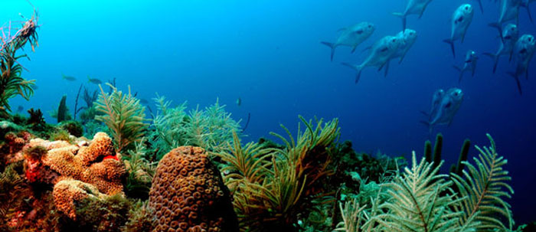
Coral Reefs
They are large under water structures formed by colonial marine invertebrate skeletons; each individual coral is called a “polyp”. Within them resides a dinoflagellate (algae). Which offers nutrients like glucose, oxygen and fixed carbon by photosynthesis using NAD+.
They are the home to over a million species.
https://floridakeys.noaa.gov/explore.html

Slide 3
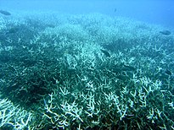
Coral Bleaching
The Cause:
  Stress (ex: temperature)
  Loss of association with symbiodinium, and thus most of it’s food source.
https://en.wikipedia.org/wiki/Coral_bleaching

Slide 4
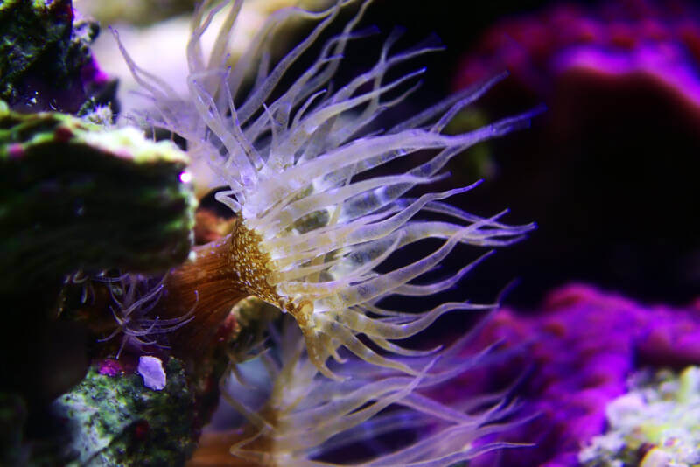
Coral Reefs: Knowing Aiptasia Pallida
Aiptasia Pallida
Anemone
Model organism
Comparatively easy to study, maintain and has a quicker life cycle.
Retains symbiotic relationship with symbodinium, therefore it is a good model for coral bleaching.

Slide 5
Coral Reefs: Knowing Aiptasia pallida
Goals
  Examine hydra metabolic function as well as learn how to both access and interpret bioinformatic data (ex: BLAST).
  Gain greater understanding of Metabolism.

Slide 6
Goals
Apply understanding of both hydra and coral metabolic function and bioinformatics data formatting to conduct and analyze genetic implications of coral metabolic function.
  Understand key components of interest: Sirtuin 1, which is activated by NAD.
  Did you know that we share Sirtuin 1 with Aiptasia? In humans, they help with metabolic processes, we hypothesize that it does the same in Aiptasia.

Slide 7
Goals
Understand Metabolism, in the absence of NAD, there might be glucose intolerance, which causes stress.
  We hypothesize that the stress is occurring because there is an absence of NAD. The algae keeps producing glucose, it causes the coral to expulse the algae by exocytosis.

Slide 8
Coral Reefs: Knowing Aiptasia pallida
Timeframe of the study
  Start date: February 12, 2022.
  End date: May 1, 2022.

Slide 9
Coral Reefs: Knowing Aiptasia Pallida
What I hope we can learn:
  I hope that we accomplish our goals.
  To find regenerating sequences, to genetic modify corals.
  That we can help restore coral reefs.

