Slide 1
Deep-learning facilitated microscopy for the dissection of durable resistance to plant disease
Student: Hening Cui, Columbia University
Mentor: Anita Schwartz , University of Delaware
Researcher: Jeffrey Caplan,
Philip Saponaro,
Randall Wisser;
University of Delaware
Date: 07/13/2022

Slide 2
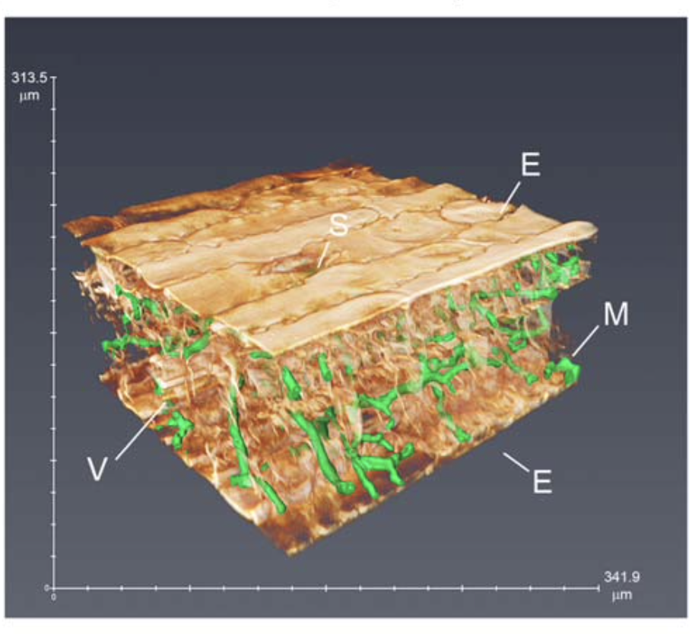
Background
High-speed confocal microscopy on plant-fungal interactions
Segmentation
  manually, infeasible for large amounts of data
  developing separate algorithms to extract individual features
Maize leaf with C. heterostrophus (green)
S: stoma
E: lower epidermis
V: Vascular bundle
M: mesophyll
Minker, K. R ., et al., 2018
Notes:
three-dimensional (3D) image data across large areas of maize leaf tissue infected with fungal pathogens

Slide 3
Method
DeepXScope
  single deep convolutional neural network architecture
  automatically segmenting hyphal networks of the fungal and host plant cell
  Github: https://github.com/drmaize/compvision
Saponaro, P. et al.,2017

Slide 4
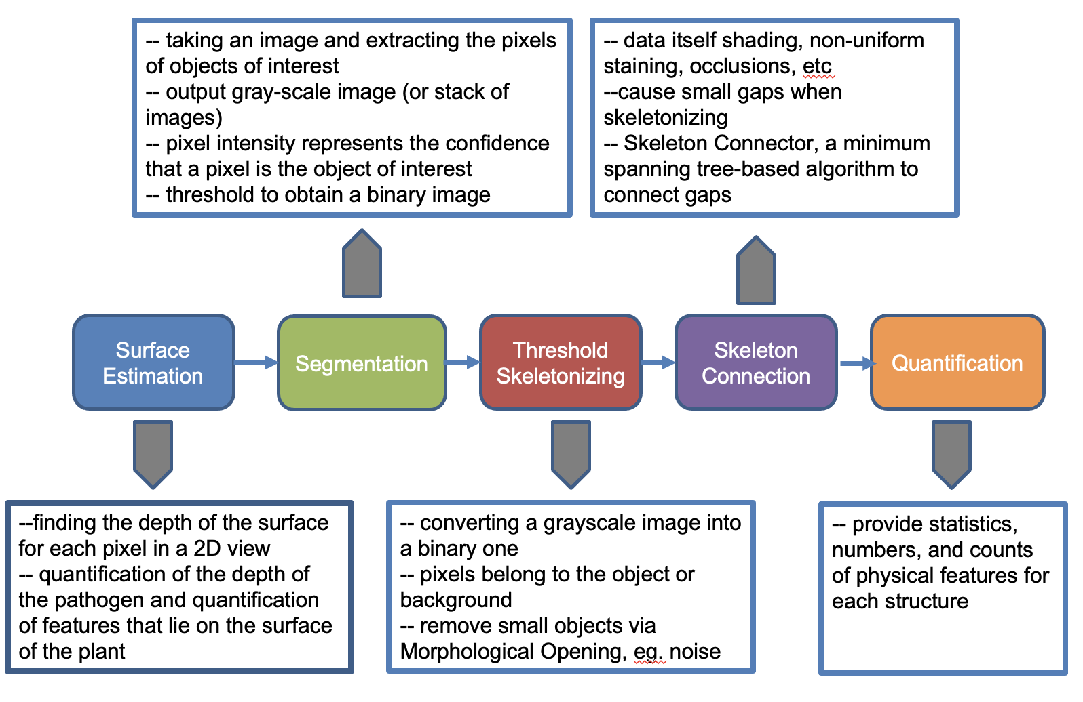
Process schema
Saponaro, P. et al.,2017

Slide 5
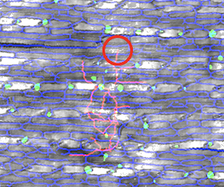
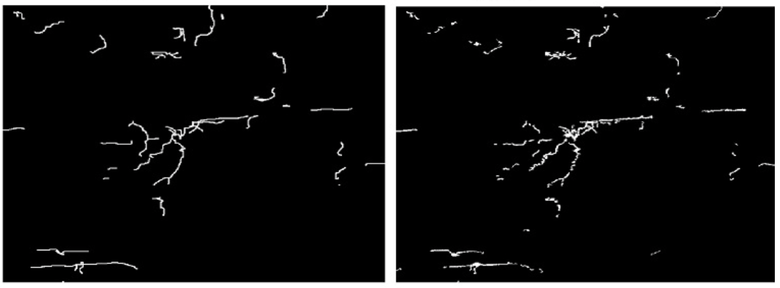
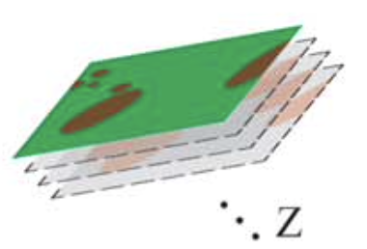
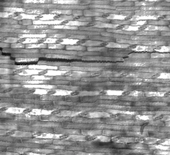


Result
Connect gaps
Raw 3D image
Quantification
Surface Estimation
Skeleton connection
2D image with depth
Extract pixel with interest
Reduce noise
Segmentation
Threshold
Skeletonizing
Minker, K. R ., et al., 2018 ; Saponaro, P. et al.,2017

Slide 6
-- taking an image and extracting the pixels of objects of interest
-- output gray-scale image (or stack of images)
-- pixel intensity represents the confidence that a pixel is the object of interest
-- threshold to obtain a binary image
-- data itself shading, non-uniform staining, occlusions, etc
--cause small gaps when skeletonizing
-- Skeleton Connector, a minimum spanning tree-based algorithm to connect gaps
Surface
Estimation
Segmentation
Threshold
Skeletonizing
Skeleton
Connection
Quantification
--finding the depth of the surface for each pixel in a 2D view
-- quantification of the depth of the pathogen and quantification of features that lie on the surface of the plant
-- converting a grayscale image into a binary one
-- pixels belong to the object or background
-- remove small objects via Morphological Opening, eg. noise
-- provide statistics, numbers, and counts of physical features for each structure

Slide 7
Goals
  Familiar with DeepXScope pipeline functions, installation, and how to process images, writing updates to the public README as needed
  Run DeepXScope on existing and incoming datasets to generate standardized output to be shared with the research team
  Test the pipeline on data collected from two other microscopy platforms
  Produce a publication quality graphical schema describing the pipeline and user interaction

Slide 8
Timeframe
  Start date: June 14th
  End date: November 6th

Slide 9
What I hope to learn
  Deep learning pipeline functioning
  Server command line
  CNN machine learning model

Slide 10
Goals for Next Month
  Generate both manually annotated and simulated ground-truth data on one dataset
  Assess accuracy of the pipeline’s segmentation routines using precision and recall metrics

Slide 11
Help Provided
Accounts sponsored by UD's ECE/CIS to access UD's Community Cluster Caviness to install DeepXScope for remote access vs using a local laptop/computer install
All the research team’s kindly help

Slide 12
References
Minker, K. R., Biedrzycki, M. L., Kolagunda, A., Rhein, S., Perina, F. J., Jacobs, S. S., ... & Caplan, J. L. (2018). Semiautomated confocal imaging of fungal pathogenesis on plants: microscopic analysis of macroscopic specimens. Microscopy research and technique, 81(2), 141-152.
Saponaro, P., Treible, W., Kolagunda, A., Chaya, T., Caplan, J., Kambhamettu, C., & Wisser, R. (2017). Deepxscope: Segmenting microscopy images with a deep neural network. In Proceedings of the IEEE conference on computer vision and pattern recognition workshops (pp. 91-98).

Slide 13
Thank you!

Slide 14
Q & A

