Slide 1
Biogeochemical cycling consequences due to the impacts on the cellular response to warming oceans
Gabrielle Armin, University of Rhode Island, garmin@uri.edu
Dr. Keisuke Inomura, University of Rhode Island, inomura@uri.edu
April 10th, 2024

Slide 2
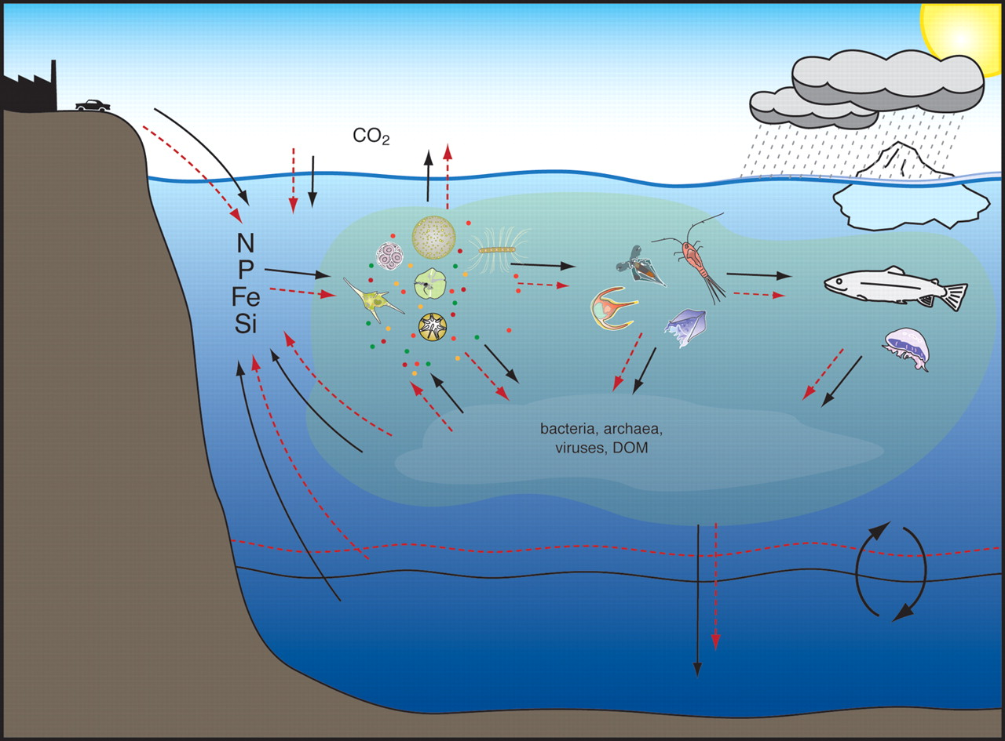
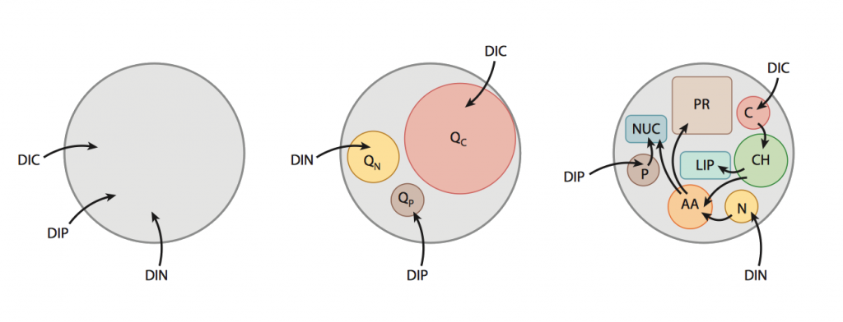
Cellular response to warming oceans
Follows and Dutkiewicz, 2011
Finkel et al., 2010
Improve computational efficiency
Integrate cell models into ecosystem models
Improve feedbacks between cell and environment
Predict future climate scenarios

Slide 3
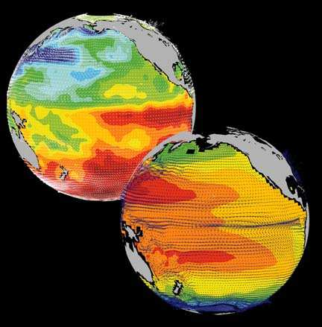
Cellular response to warming oceans
Essential Molecules
Photosynthesis
Storage
Biosynthesis
The Cell Flux Model of Phytoplankton
MIT’s General Circulation Model
Inomura et al., 2020
MITgcm group 2023

Slide 4
Cellular response to warming oceans
Goals
Integrate temperature dependent CFM into MITgcm
Compare to previous model
Climate change scenario

Slide 5
Cellular response to warming oceans
Timeframe
November 2023
April 2024

Slide 6
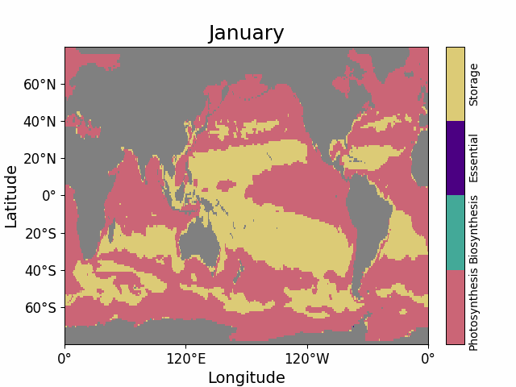
Integrate temperature dependent CFM into MITgcm

Slide 7
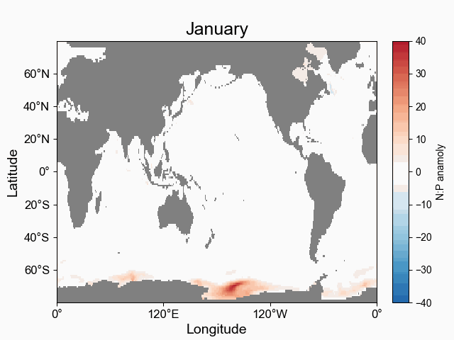
Compare to previous model

Slide 8
Climate Change Scenario

Slide 9
Lessons Learned
Technical side: using HPC, running the model, data file
Research side: simplest form of ecosystem model
Going to step up in complexity: adding zooplankton
Longer simulation

Slide 10
Publications/Contributions
Presentation at Ocean Sciences Meeting
Armin G, (2024). Quantifying temperature dependencies of elemental stoichiometry and macromolecular allocation in marine phytoplankton. Ocean Sciences Meeting. Oral presentation.
Publications
Armin G, Sharoni S, Follows M, and Inomura K. TBD
Armin G, Chapter 4: Testing a temperature dependent model of macromolecular allocation from local regions to global, Quantifying links between the environment and cell. TBD

Slide 11
Contributions to Research
Computing Community
Github contributions
https://github.com/gmarmin10/darwin_macromol

Slide 12
Thank you for the support and opportunity!

