Slide 1
Biogeochemical cycling consequences due to the impacts on the cellular response to warming oceans
Gabrielle Armin, PhD Candidate, Graduate School of Oceanography, University of Rhode Island, garmin@uri.edu
Dr. Keisuke Inomura, Graduate School of Oceanography, University of Rhode Island, inomura@uri.edu
November 8, 2023

Slide 2
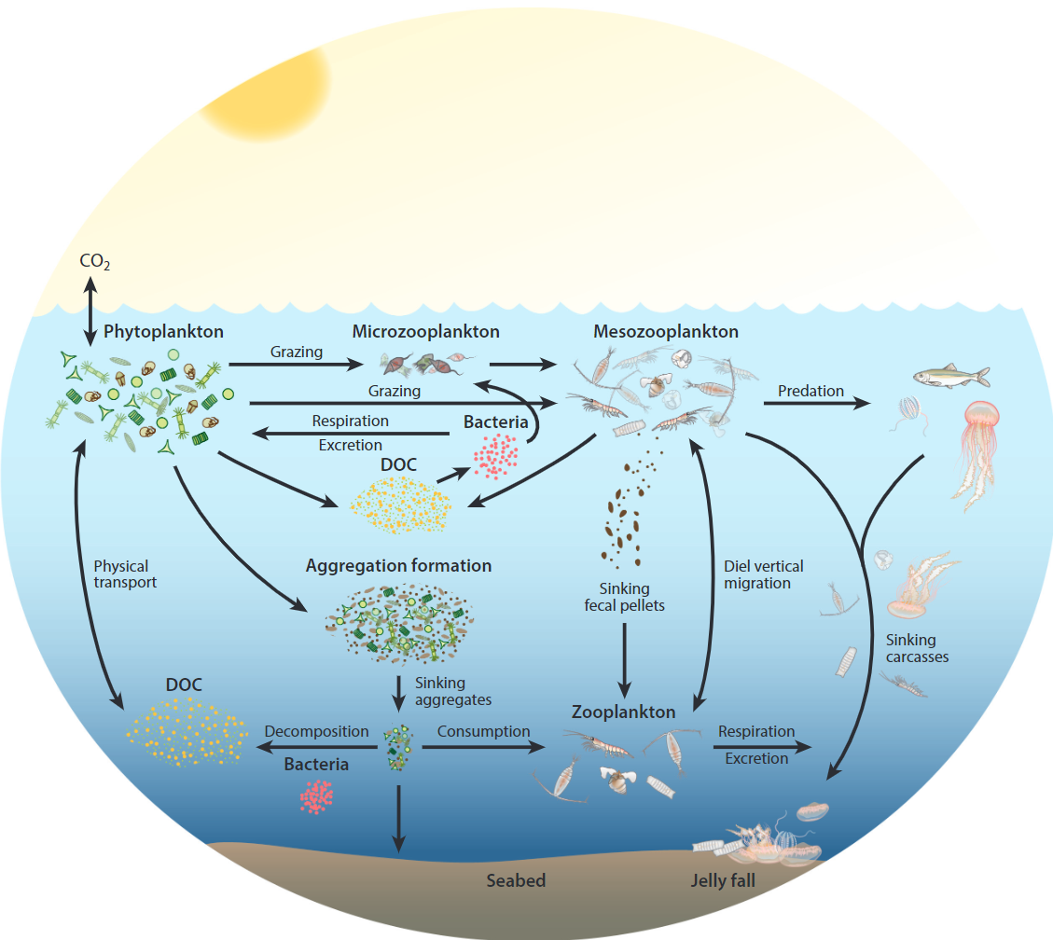
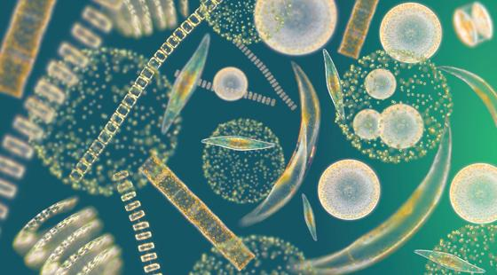
The cellular response to warming oceans
Steinberg and Landry, 2017

Slide 3
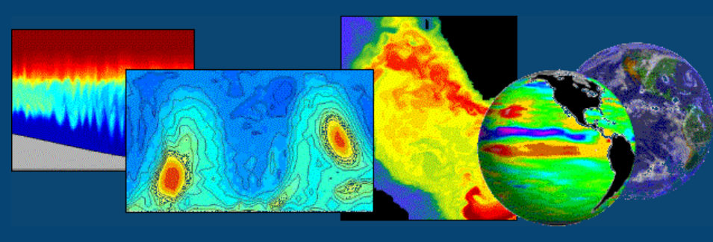
The cellular response to warming oceans
CFM-Phyto-T
Elemental Stoichiometry
Macromolecular Allocation
Temperature Dependence
MIT-gcm
Ocean Circulation
Biogeochemical Cycling
Ecosystem Interactions
Future Predictions
Elemental Stoichiometry
Carbon Export
Armin and Inomura 2021

Slide 4
The cellular response to warming oceans
Goals
Include CFM-Phyto in MIT-gcm’s representation of phytoplankton
Run various temperature scenarios
Evaluate/quantify the impact of the cell’s response to warming on global ocean cycles.

Slide 5
The cellular response to warming oceans
Timeframe
November 1, 2023
April 30, 2024

Slide 6
The cellular response to warming oceans
What I hope to learn
What are the emerging stoichiometric patterns?
How do these patterns compare to existing observations?
How does including CFM-Phyto into a global scale model change the predictions of future warming scenarios?
HPC use

Slide 7
The cellular response to warming oceans
Goals for Next Month
HPC access, GitHub setup
Setting up MITgcm
Coupling CFM

Slide 8
Questions?

