Slide 1

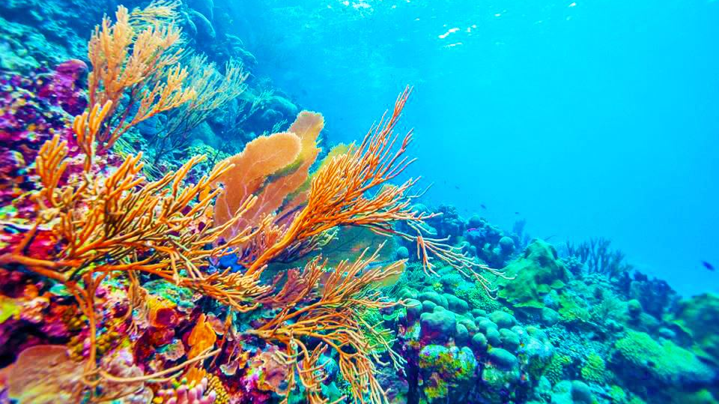
Discovering the Structure, Function, and Evolution of Sirtuins and Associated Proteins in Aiptasia: A Deep Learning and Integrative Genomics Approach
Student: Samantha Kidwell
skidwell001@my.wilmu.edu
Mentors: Milton Muldrow Jr., PhD
milton.x.muldrow@wilmu.edu
Daniel Chauss
daniel.chauss@nih.gov
Researcher: Milton Muldrow Jr., PhD
milton.x.muldrow@wilmu.edu

Slide 2

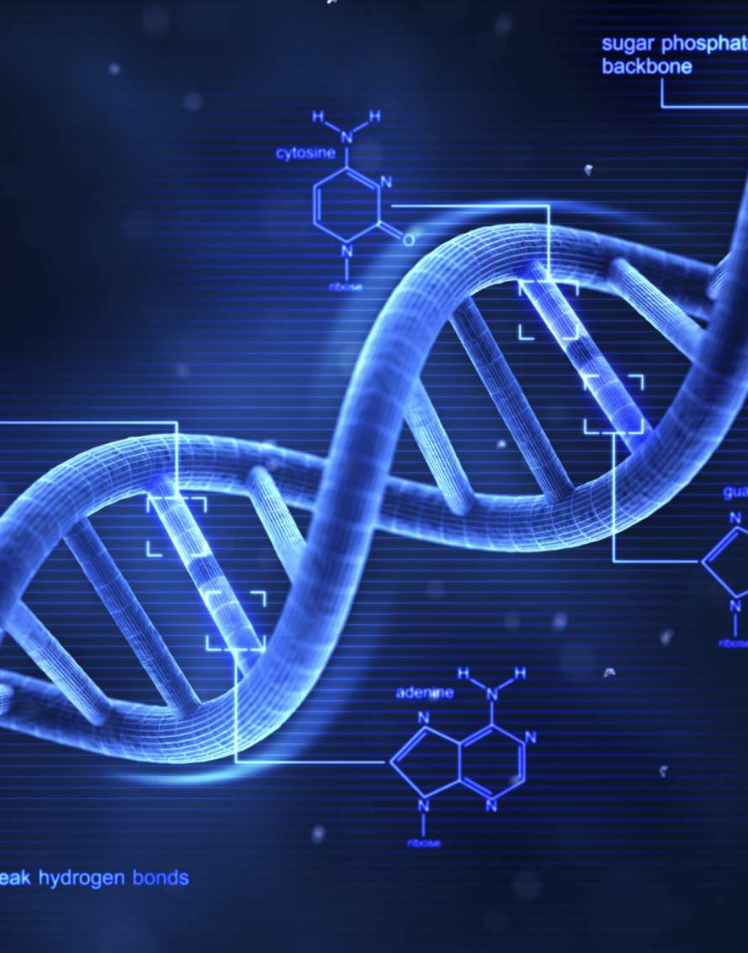
Abstract
Gain a deeper knowledge of coral biology through protein folding using AI technology and high-performance computing. By using these technologies, it will allow for a more precise understanding of attachment sites of Sirtuin proteins in multiple species of coral that could lead to answers to underlying mechanisms of coral bleaching.

Slide 3
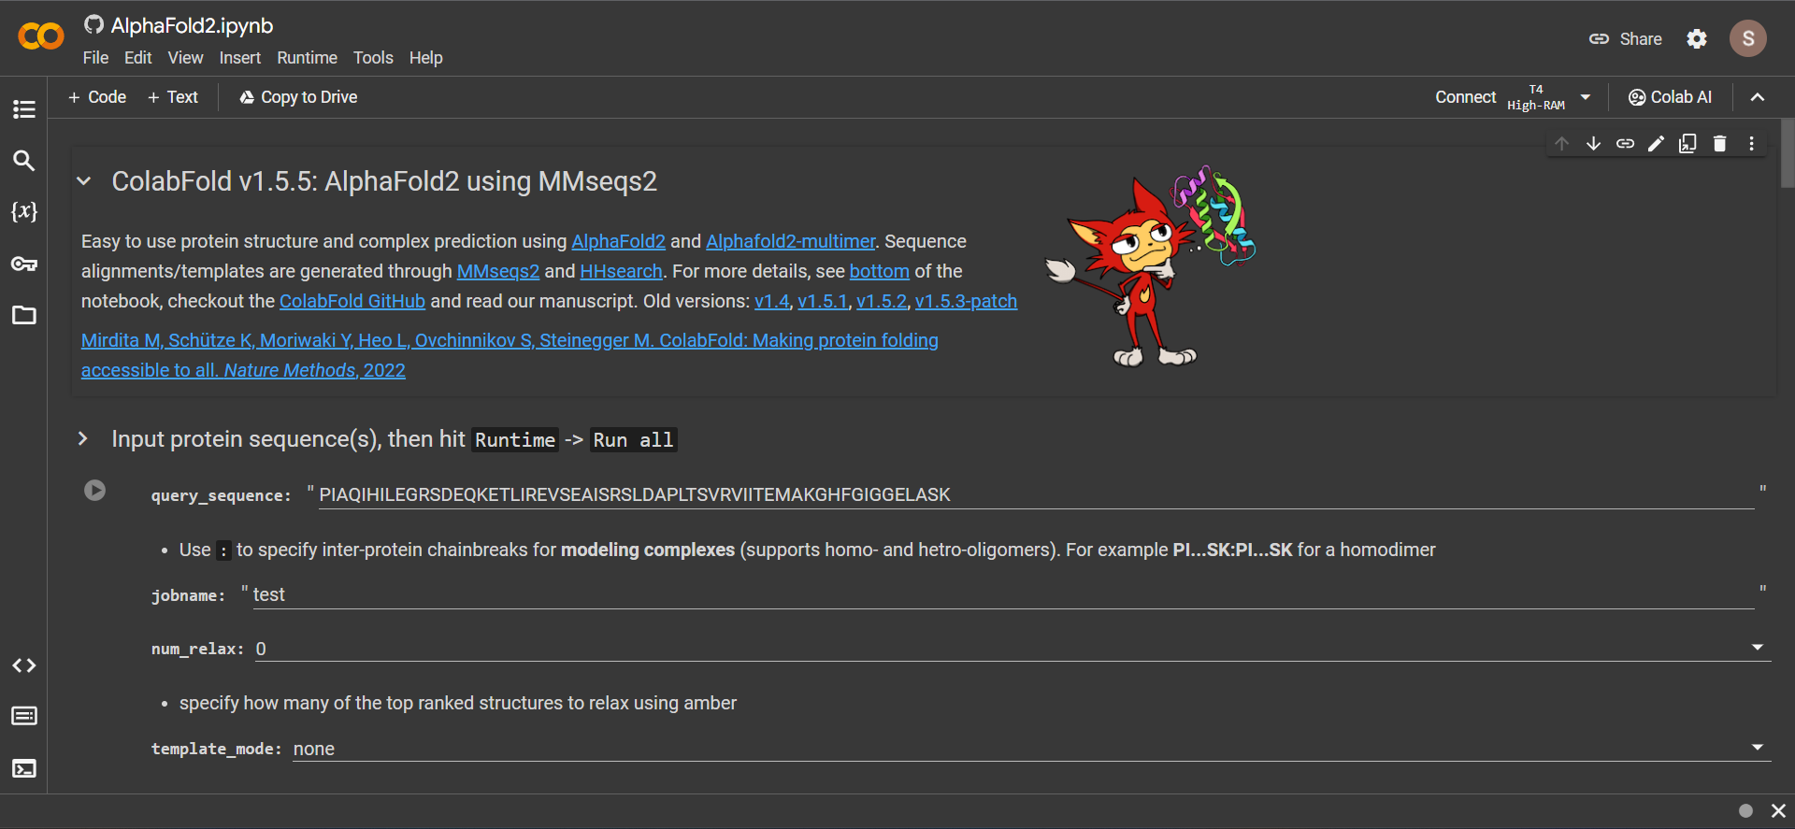
Research Goals
Examine potential protein interactions (e.g., NAD+). Become familiar with AlphaFold and ColabFold, RCSB Protein Data Bank, and ChimeraX.

Slide 4
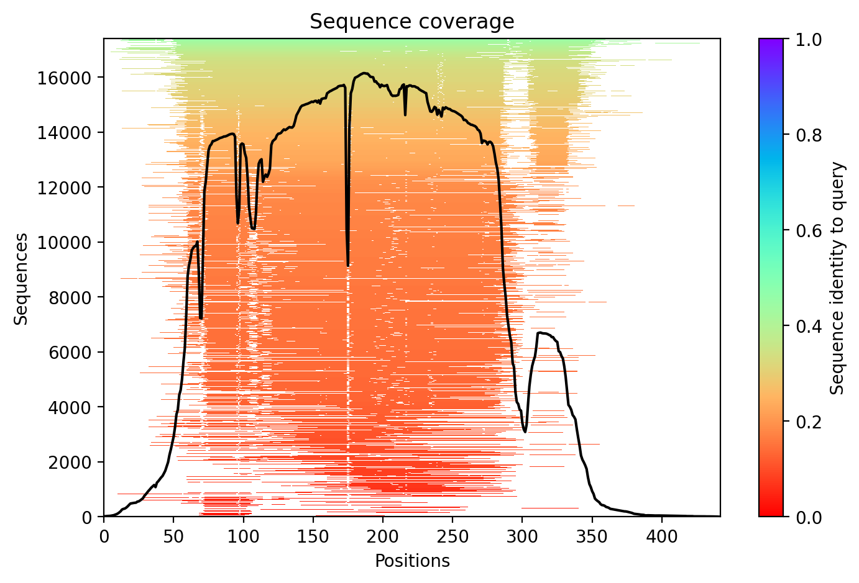
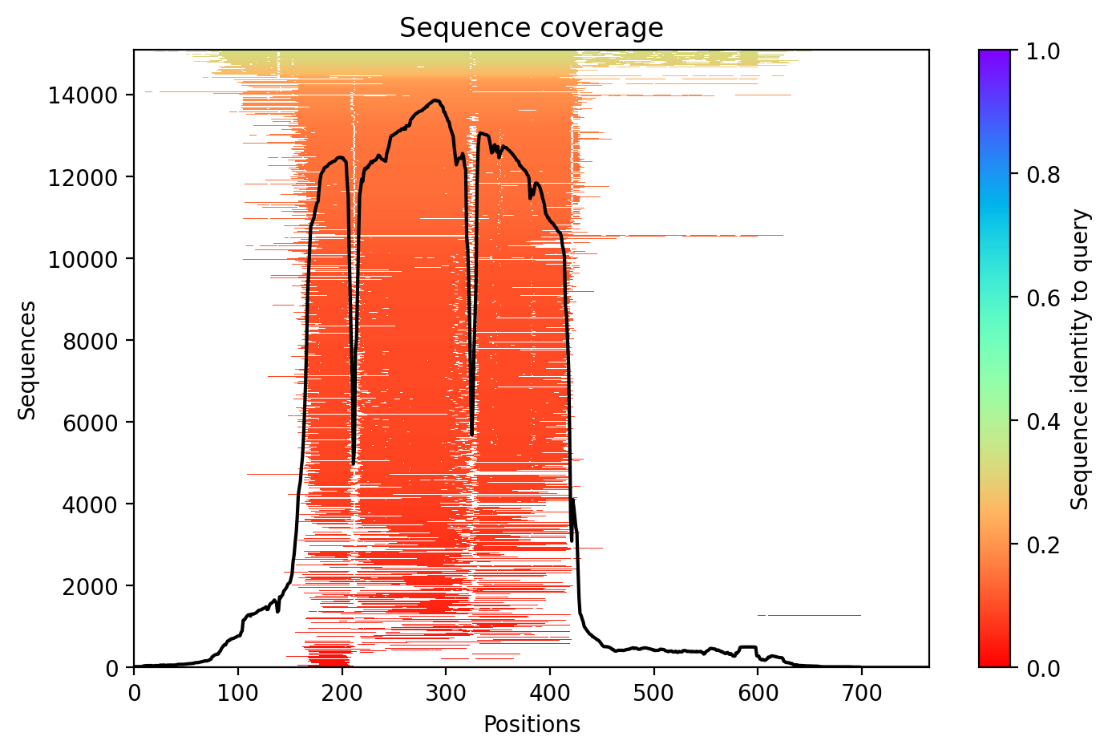
Research Goals
Compare protein functional sites across taxa (e.g., active and binding sites) to develop hypotheses regarding function.
Compare predicted sample sequence with actual sirtuin protein sequences of Aiptaisa Pallida received from Delaware INBRE.

Slide 5
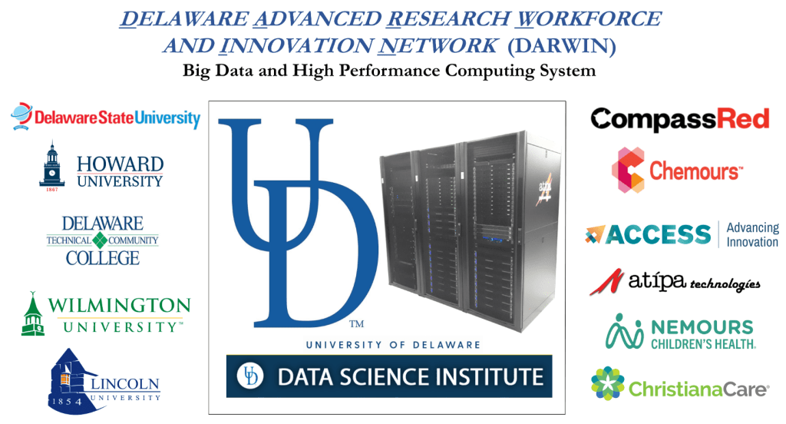
Research Goals
Learn to use the DARWIN high performance computing system at the University of Delaware.

Slide 6
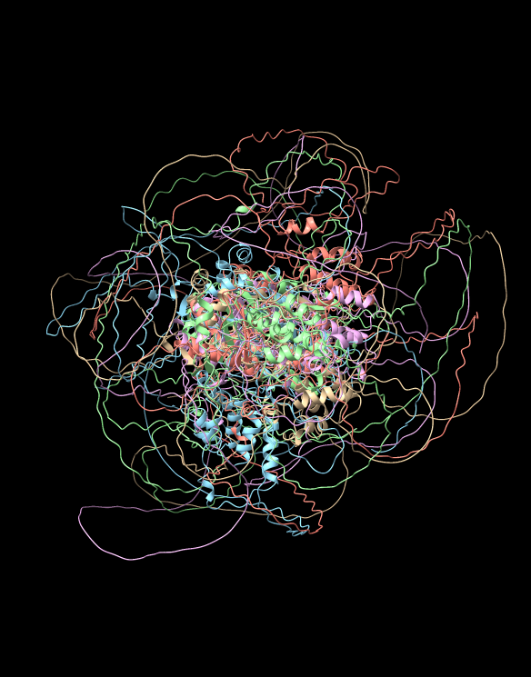
Research Goals
Utilize the DARWIN system for the integrative analysis of structural, functional and evolutionary data.
Utilize the DARWIN system to compare actual sequenced sirtuin proteins to predicted sample from AlphaFold and ColabFold.

