Slide 1
Deep Convolutional Neural Networks (dCNN) for Image Segmentation, Instance Labeling, and Tracking
Student: Huining Liang, Yi Liu, Wayne Treible, University of Delaware
Mentor: Chandra Kambhamettu, University of Delaware
Researcher: Jeffrey Caplan, Kun Huang, University of Delaware
Date 2/10/2020

Slide 2
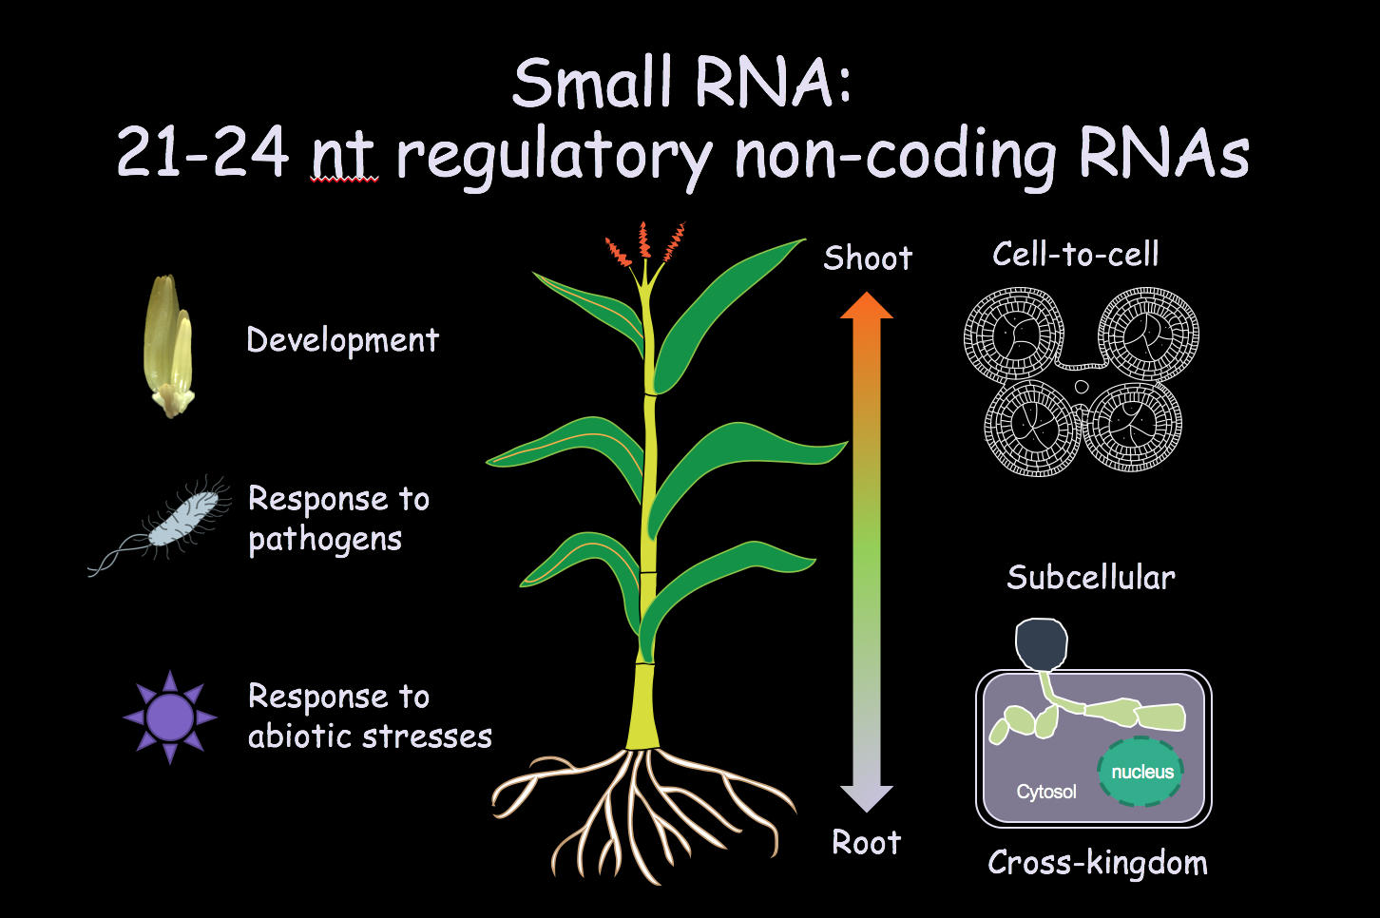
DCNN for Image Segmentation, Instance Labeling, and Tracking

Slide 3
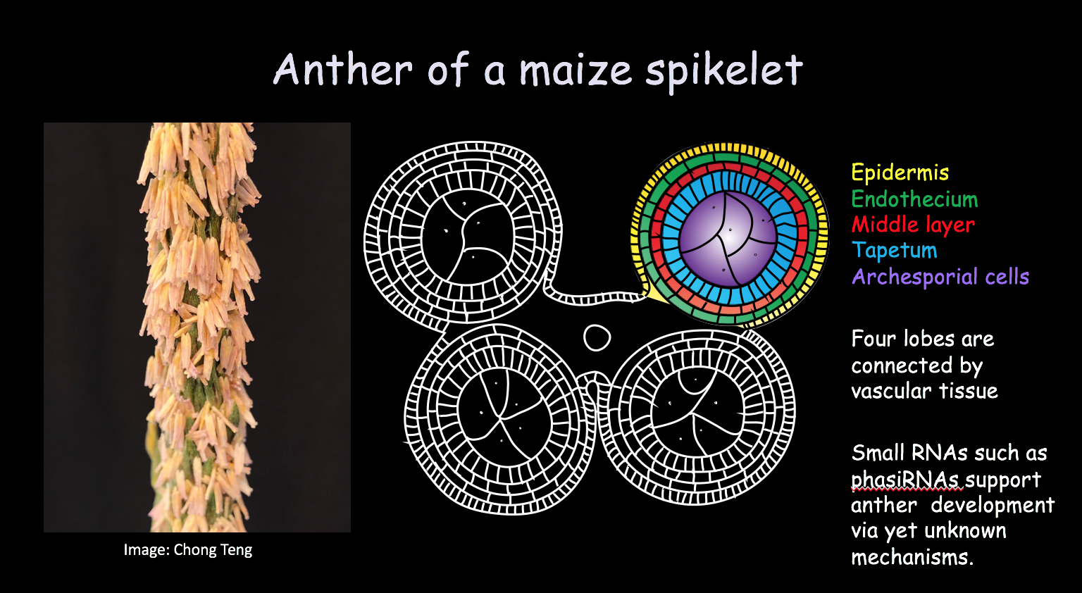
DCNN for Image Segmentation, Instance Labeling, and Tracking

Slide 4
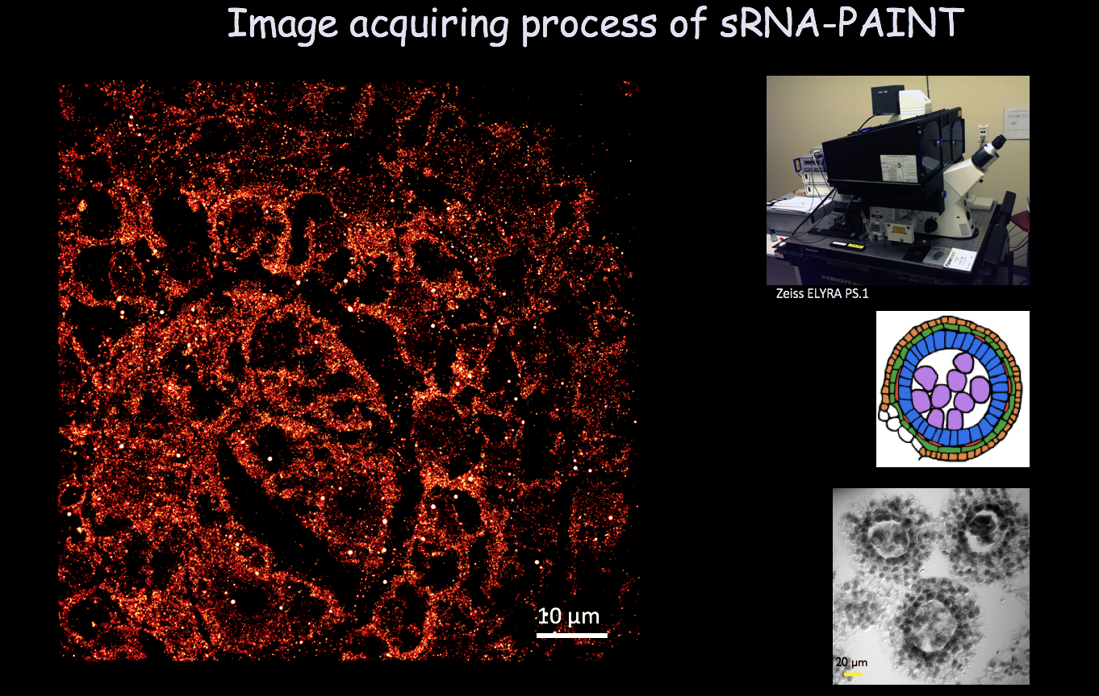
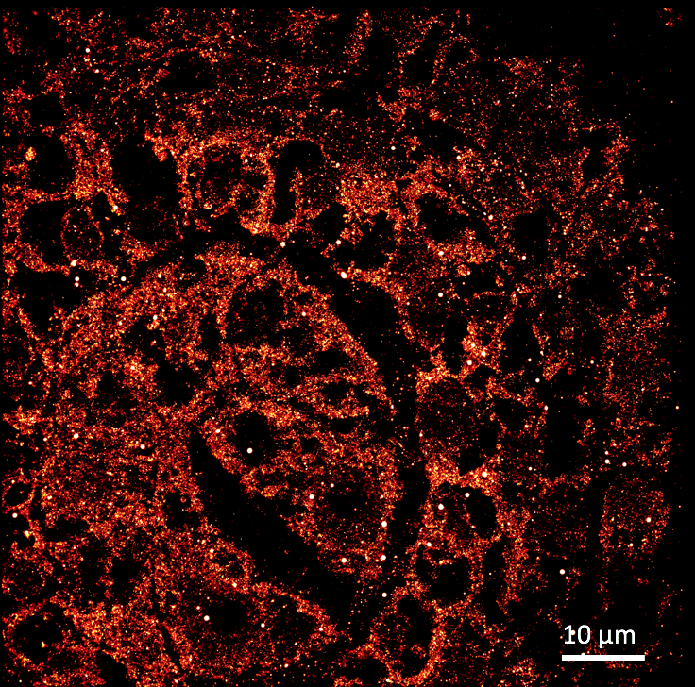
DCNN for Image Segmentation, Instance Labeling, and Tracking

Slide 5
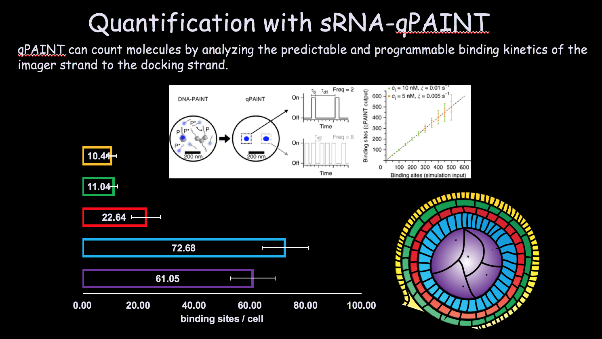
DCNN for Image Segmentation, Instance Labeling, and Tracking

Slide 6
DCNN for Image Segmentation, Instance Labeling, and Tracking

Slide 7
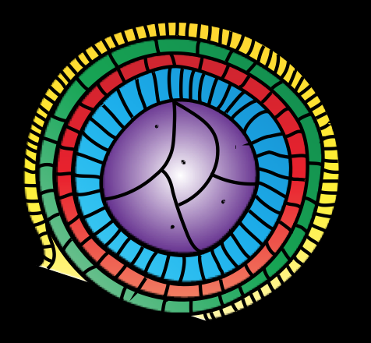
DCNN for Image Segmentation, Instance Labeling, and Tracking

Slide 8
DCNN for Image Segmentation, Instance Labeling, and Tracking

Slide 9
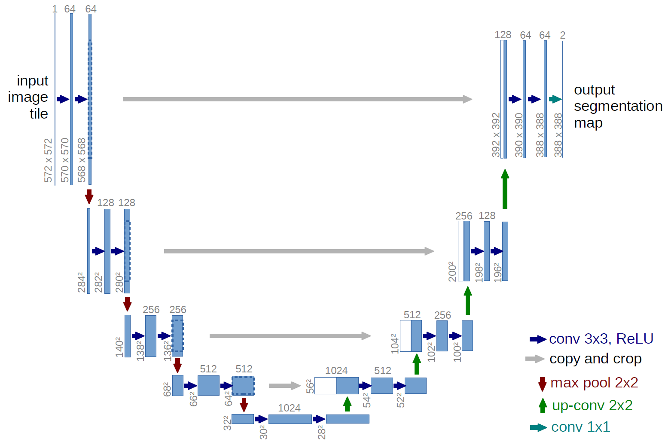
DCNN for Image Segmentation, Instance Labeling, and Tracking
Adapt the U-net architecture from Ronnebereger et al. 2015
Shown state-of-the-art results with biological data
Can be trained end-to-end with low number of samples
2D segmentation

Slide 10
DCNN for Image Segmentation, Instance Labeling, and Tracking
Goals
Milestone 1: Estimate segmentation on new images of tissue layers.
U-Net model
Limited data set ---Data augmentation
Milestone 2: Manually fix errors in the new predictions to increase the size of the training data set.
Milestone 3: Classify different cell types and tissue layers after adequate segmentation.

Slide 11
DCNN for Image Segmentation, Instance Labeling, and Tracking
Timeframe
Start date: February 15, 2021
End date: August 15, 2021

Slide 12
DCNN for Image Segmentation, Instance Labeling, and Tracking
What I hope to learn
Train a U-Net model for segmentation and use data augmentation to deal with limited data set.
Explore a mixed pipeline that takes U-Net and U-Net with multiple channels for segmentation and classification respectively.
Facilitate research with machine learning methods and HPC resources.

Slide 13
DCNN for Image Segmentation, Instance Labeling, and Tracking
Goals for Next Month
Learn about use and access to the Biomix cluster and the DARWIN HPC resource at the University of Delaware.
Work on the U-Net for segmentation of cells in corn anthers.
Train the model with augmented data set and evaluate its performance of segmentation.

Slide 14
Thank you!

